Slide 1
Intelligent Robotics
WID3005
Sensors
Sonar ** Laser ** Vision
Theoretical Considerations in Design

Slide 2
Sensors
Physical devices that provide information about the world
Based on the origin of the received stimuli we have:
  Proprioception: sensing internal state - stimuli arising from within the agent (e.g., muscle tension, limb position)
  Exteroception: sensing external state – external stimuli (e.g., vision, audition, smell, etc.)
The ensemble of proprioceptive and exteroceptive sensors constitute the robot’s perceptual system

Slide 3
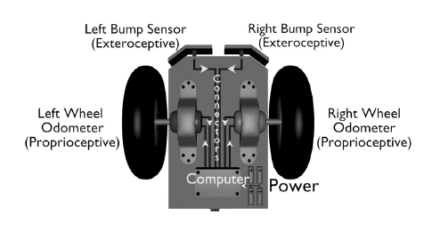

Slide 4
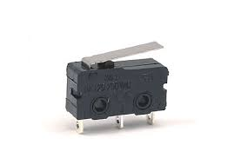
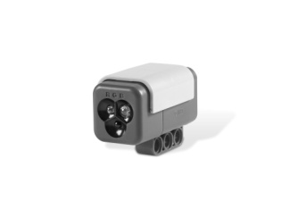
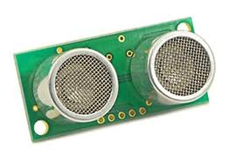
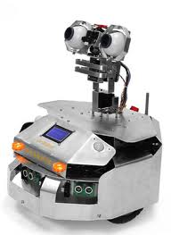
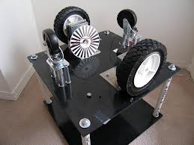
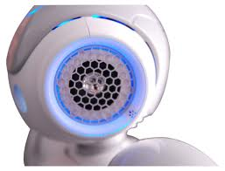
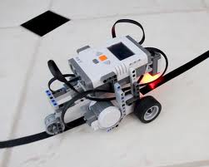
Sensor Examples
Physical Property
Sensor
contact
switch
distance
ultrasound, radar, infrared
light level
photocells, cameras
sound level
microphone
rotation
encoders and potentiometers
acceleration
accelerometers gyroscopes

Slide 5
More Sensor Examples
Physical Property
Sensor
magnetism
compass
smell
chemical
temperature
thermal, infra red
inclination
inclinometers, gyroscopes
pressure
pressure gauges
altitude
altimeters
strain
strain gauges

Slide 6
Knowing what’s Going On
Perceiving environmental state is crucial for the survival or successful achievement of goals
Why is this hard?
  Environment is dynamic
  Only partial information about the world is available
  Sensors are limited and noisy
  There is a lot of information to be perceived
Sensors do not provide state
Sensors are physical devices that measure physical quantities

Slide 7
Types of Sensors
Sensors provide raw measurements that need to be processed
Depending on how much information they provide, sensors can be simple or complex
Simple sensors:
  A switch: provides 1 bit of information (on, off)
Complex sensors:
  A camera: 512x512 pixels
  Human retina: more than a hundred million photosensive elements

Slide 8
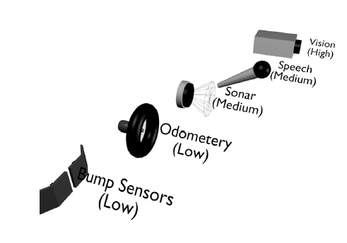

Slide 9
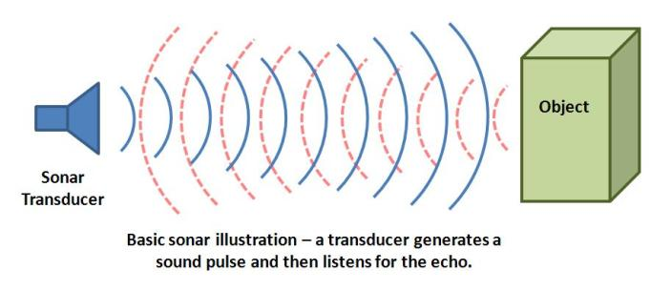
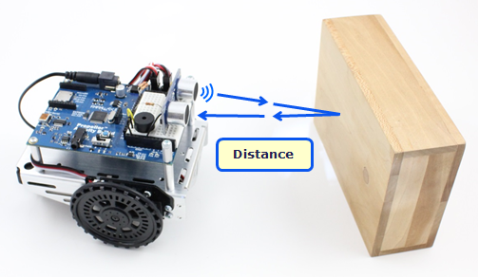
Sonar (Sound Echo)

Slide 10

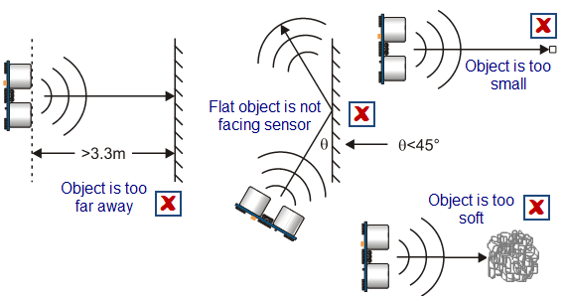
Sonar Design
CS 491/691(X) - Lecture 4

Slide 11
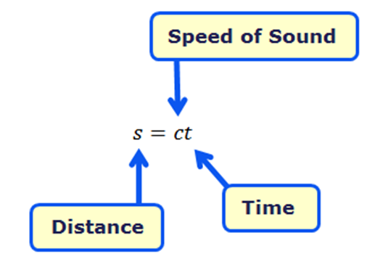



Distance Estimation with Sonar
the echo pulse in terms of microseconds and then uses the fact that sound travels at 0.03448 cm/µs at room temperature. That’s 3.448 hundredths of a centimeter per millionth of a second at a temperature of (22.2 ºC). Just as a car travels distance = speed x time, so does sound, with an equation of s = ct, where s is the distance, c is the speed of sound and t is the time.
To calculate the distance of an echo, remember that the time measurement is for twice the distance (there and back)
Divide both sides by 2, the equation for distance from a time measurement is
Since 0.03448/2 ≈ 1/58, the equation for cm distance
from microsecond echo time is

Slide 12
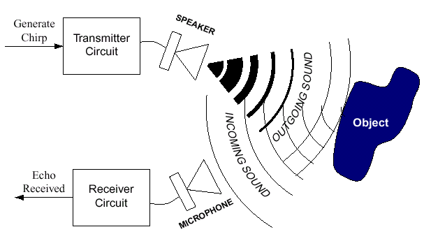
Ultrasonic Distance Sensing
Sonars: so(und) na(vigation) r(anging)
Based on the time-of-flight principle
The emitter sends a “chirp” of sound
If the sound encounters a barrier it reflects back to the sensor
The reflection is detected by a receiver circuit, tuned to the frequency of the emitter
Distance to objects can be computed by measuring the elapsed time between the chirp and the echo
Sound travels about 0.89 milliseconds per foot

Slide 13
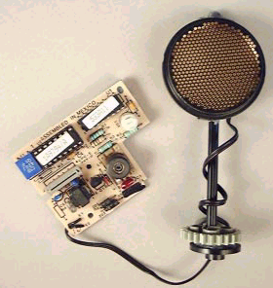
The Ping Pulse
Emitter is a membrane that transforms mechanical energy into a “ping” (inaudible sound wave)
The receiver is a microphone tuned to the frequency of the emitted sound
Polaroid Ultrasound Sensor
  Used in a camera to measure the
  distance from the camera to the subject
  for auto-focus system
  Emits in a 30 degree sound cone
  Has a range of 32 feet
  Operates at 50 KHz

Slide 14
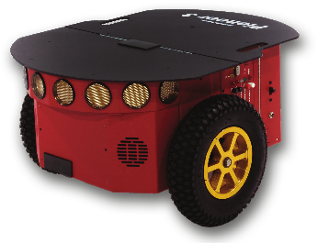
Each cone beam emits roughly 30 degrees angle of sound wave
The pioneer 3dx robot (below) has 8-rings of cone beams
CS 491/691(X) - Lecture 4

Slide 15


Echolocation
Echolocation = finding location based on sonar
Numerous animals use echolocation
Bats use sound for:
  finding pray, avoid obstacles, find mates,
  communication with other bats
Dolphins/Whales:
  find small fish, swim through mazes
Natural sensors are much more complex than artificial ones

Slide 16
Specular Reflection
Sound does not reflect directly and come right back
Specular reflection
  The sound wave bounces off multiple sources before returning to the detector
Smoothness
  The smoother the surface the more likely is that the sound would bounce off
Incident angle
  The smaller the incident angle of the sound wave the higher the probability that the sound will bounce off

Slide 17
Improving Accuracy
Use rough surfaces in lab environments
Multiple sensors covering the same area (overlapping of sensory data)
Multiple readings over time to detect “discontinuities”
Active sensing
In spite of these problems sonars are used successfully in robotics applications
  Navigation
  Mapping

Slide 18
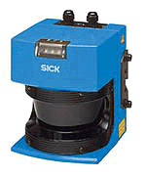
Laser Sensing
High accuracy sensor
Lasers use light time-of-flight
Light is emitted in a beam (3mm) rather than a cone
Provide higher resolution
For small distances light travels faster than it can be measured ⇒ use phase-shift measurement
E.g. SICK LMS200
  360 readings over an 180-degrees, 10Hz
Disadvantages:
  cost, weight, power, price, goes through glass
  mostly 2D

Slide 19
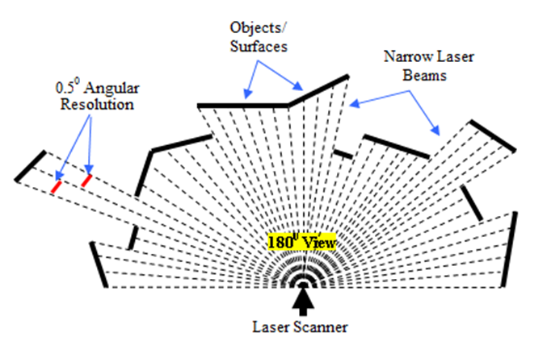
Laser Sensing
Also time-of-flight principles
The laser taking samples from the environment at 0.5⁰ angular resolutions with 180⁰ scanning field.
Drawings of the narrow laser beams are an approximate and not to scale
CS 491/691(X) - Lecture 4

Slide 20
Visual Sensing
Cameras try to model biological eyes
Machine vision is a highly difficult research area
  Reconstruction
  What is that? Who is that? Where is that?
Robotics requires answers related to achieving goals
  Not usually necessary to reconstruct the entire world
Applications
  Security, robotics (mapping, navigation)

Slide 21
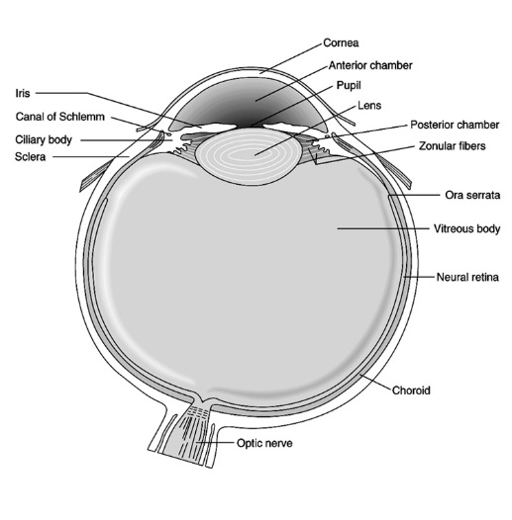
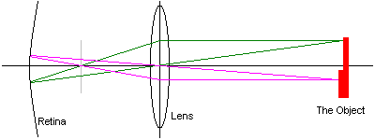
Principles of Cameras
Cameras have many similarities with the human eye
  The light goes through an opening (iris - lens) and hits the image plane (retina)
  The retina is attached to light-sensitive elements (rods, cones – silicon circuits)
  Only objects at a particular range are
  in focus (fovea) – depth of field
  512x512 pixels (cameras),
  120x10⁶ rods and 6x10⁶ cones (eye)
  The brightness is proportional to the
  amount of light reflected from the objects

Slide 22


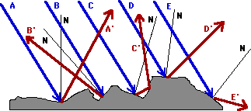
Image Brightness
Brightness depends on
  reflectance of the surface patch
  position and distribution of the light sources in the environment
  amount of light reflected from other objects in the scene onto the surface patch
Two types of reflection
  Specular (smooth surfaces)
  Diffuse (rough sourfaces)
Necessary to account for these properties for correct object reconstruction ⇒ complex computation

Slide 23
Early Vision
The retina is attached to numerous rods and cones which, in turn, are attached to nerve cells (neurons)
The nerves process the information; they perform "early vision", and pass information on throughout the brain to do "higher-level" vision processing
The typical first step ("early vision") is edge detection, i.e., find all the edges in the image
Suppose we have a b&w camera with a 512 x 512 pixel image
Each pixel has an intensity level between white and black
How do we find an object in the image? Do we know if there is one?

Slide 24
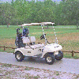
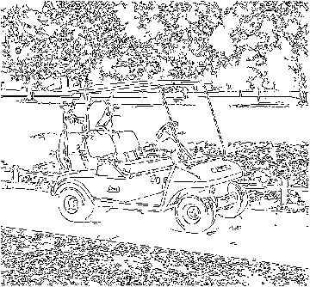
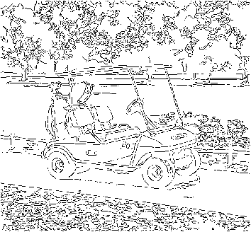
Edge Detection
Edge = a curve in the image across which there is a change in brightness
Finding edges
  Differentiate the image and look for areas where the magnitude of the derivative is large
Difficulties
  Not only edges produce changes in brightness: shadows, noise
Smoothing
  Filter the image using convolution
  Use filters of various orientations
Segmentation: get objects out of the lines

Slide 25
Model-Based Vision
Compare the current image with images of similar objects (models) stored in memory
Models provide prior information about the objects
Storing models
  Line drawings
  Several views of the same object
  Repeatable features (two eyes, a nose, a mouth)
Difficulties
  Translation, orientation and scale
  Not known what is the object in the image
  Occlusion

Slide 26
Vision from Motion
Take advantage of motion to facilitate vision
Static system can detect moving objects
  Subtract two consecutive images from each other ⇒ the movement between frames
Moving system can detect static objects
  At consecutive time steps continuous objects move as one
  Exact movement of the camera should be known
Robots are typically moving themselves
  Need to consider the movement of the robot

Slide 27
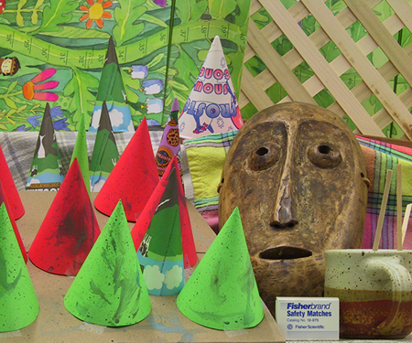
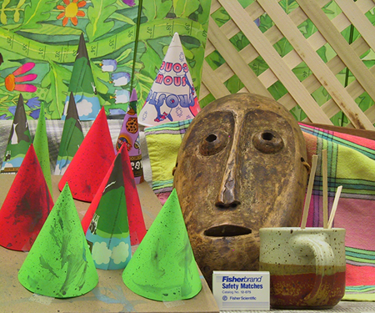
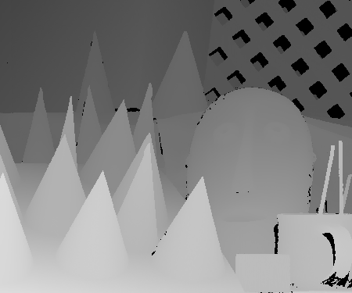
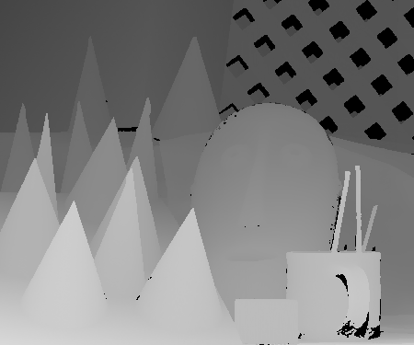
Stereo Vision (dual cameras)
3D information can be
computed from two
images
Compute relative
positions of cameras
Compute disparity
  displacement of a point in
  3D between the two images
Disparity is inverse proportional with actual distance in 3D

Slide 28
Biological Vision
Similar visual strategies are used in nature
Model-based vision is essential for object/people recognition
Vestibular occular reflex
  Eyes stay fixed while the head/body is moving to stabilize the image
Stereo vision
  Typical in carnivores
Human vision is particularly good at recognizing shadows, textures, contours, other shapes

Slide 29
Vision for Robots
If complete scene reconstruction is not needed we can simplify the problem based on the task requirements
Use color
Use a combination of color and movement
Use small images
Combine other sensors with vision
Use knowledge about the environment

Slide 30
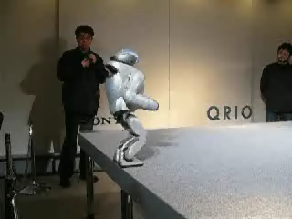
Examples of Vision-Based Navigation
Running QRIO
Sony Aibo – obstacle avoidance

Slide 31
Perception Designs
Always think about design in terms of following items:
  The task the robot has to perform
  The best suited sensors for the task
  The best suited mechanical design that would allow the robot to get the necessary sensory information for the task (e.g. body shape, placement of the sensors)

Slide 32
Types of Perceptual Design
Action-oriented perception
  How can perception provide the information necessary for behavior?
  Perceptual processing is tuned to meet motor activity needs
  World is viewed differently based on the robot’s intentions
  Only the information necessary for the task is extracted
Active perception
  How can motor behaviors support perceptual activity?
  Motor control can enhance perceptual processing
  Intelligent data acquisition, guided by feedback and a priori knowledge

Slide 33
Using A Priori Knowledge of the World
A priori = available knowledge about the world
Expectation-based perception (what to look for)
  Knowledge of the world constraints the interpretation of sensors
Focus of attention methods (where to look for it)
  Knowledge can constrain where things may appear
Perceptual classes (how to look for it)
  Partition the world into categories of interaction

Slide 34
Sensor Fusion
A man with a watch knows what time it is;
a man with two watches isn’t so sure
Combining multiple sensors to get better information about the world
Sensor fusion is a complex process
  Different sensor accuracy
  Different sensor complexity
  Contradictory information
  Asynchronous perception
Cleverness is needed to put this information together

Slide 35
Neuroscientific Evidence
Our brain process information from multiple sensory modalities
  Vision, touch, smell, hearing, sound
Individual sensory modalities use separate regions in the brain (sight, hearing, touch)
Vision itself uses multiple regions
  Two main vision streams: the “what” (object recognition) and the “where” (position information)
  Pattern, color, movement, intensity, orientation

Slide 36
What Can We Learn from Biology?
Sensor function should decide its form
Evolved sensors have specific geometric and mechanical properties
Examples
  Flies: complex facetted eyes
  Birds: polarized light sensors
  Bugs: horizon line sensors
  Humans: complicated auditory systems
Biology uses clever designs to maximize the sensor’s perceptual properties, range and accuracy

Slide 37
How to Use Sensors to Detect People?
Camera: great deal of processing
Movement: if everything else is static: movement means people
Color: If you know the particular color people wear
Temperature: can use sensors that detect the range of human body heat
Distance: If any open-range becomes blocked

Slide 38
How to Use Sensors to Measure Distance?
Ultrasound sensors (sonar) provide distance measurement directly (time of flight)
Infra red sensors provide return signal intensity
Two cameras (i.e., stereo) can be used to compute distance/depth
A laser and a camera: triangulate distance
Laser-based structured light: overly grid patterns on the world, use distortions to compute distance

Slide 39

Readings
M. Matarić: Chapters 7, 8, 9

